Slide 1

IV. How to Enter and Prepare for Mediation in Trademark Disputes
Mediation of Trademark Disputes
Tel Aviv
December 11, 2014
Jonathan Agmon, Soroker-Agmon
Ignacio de Castro, WIPO Arbitration and Mediation Center
Jon Lang, Jon Lang Mediation
Keren Wineberg-Ayal

Slide 2
Pre-mediation steps
ADR options
  arbitration, mediation, med-arb, arb-med, expert determination, early neutral evaluation
  what do clients want?
    a merits based adjudication (to be right)
    or a commercial resolution giving primacy to commercial interests (to get it sorted)
    other considerations – speed, resources, relationships,

Slide 3
Mediation Options – Israeli Law
WIPO
Civil Procedure
  Certain cases must go to mediation (Civil, 75)
  First meeting is free
Trademark cases
  S. 29 + S.30
  None for other procedures
Other jurisdictions show this can be done for Trademark disputes

Slide 4
Raising mediation and agreements to mediate
Raising mediation
  Sign of weakness?
  Assistance – the judges, procedural rules, corporate pledges (http://www.cpradr.org/About/CPRPledges.aspx)
Agreements to mediate
  Enforceability
  Before the event
  After the event

Slide 5
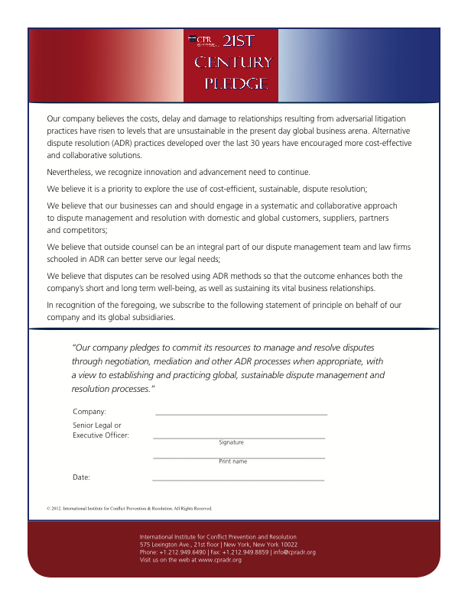
21st Century Pledge
International Institute for Conflict Prevention and Resolution

Slide 6
Assembling the mediation team
Why assembling the right team is of paramount importance
  Lack of adjudicative element
  Importance of working with opposition
  Difficulty of working with opposition!
  Effective messaging
  Who?

Slide 7
Risk Assessment
BATNA’s, WATNA’s, ZOPA’s
It is not just the merits!
  Expenditure of resources
  Finality
  Certainty
  Relationships
  Endurance!
Avoid common ‘traps’
  Investment
  Confirmation
  Inertia

Slide 8
Goals and Strategies
Identification of interests
  What do the clients really want?
How will they get it?
Sowing the seeds of doubt!
Underpinning proposals
The best deal (for who)?

Slide 9
Pre-mediation meetings (internal)
Assemble the team
  Key messages
  Who delivers?
  Key points to consider
    Merits and more
    Peripheral considerations
    Settlement considerations
Effective preparation
  dummy runs and devil’s advocates
Pit falls
  ‘group thinks’, ignoring the ‘doves’ and other errors!

Slide 10
The mediator
What makes an ideal Mediator?
The task at hand…
  to give the parties the best chance of reaching a solution that is quicker, less expensive and better suited to their dispute than any alternative form of dispute resolution
Key tasks
  Sounding board
  Proponent/effective voice
  Traction
So, who do you want?

Slide 11
Commencement of the Mediation
Submitting the Mediation Request
  IPOS procedure
  Generally
Selection and appointment of mediator
  WIPO
  Generally
Ground Rules
  WIPO
  Generally
Pre-mediation meetings (with mediator)
Other communications?

Slide 12
Agreement and Request for WIPO Mediation in Trade Mark Proceedings
(under Article 3 of the WIPO Mediation Rules)
Reference is made to Trade Mark No. [Insert Reference] in the name of [Insert Name of TM Applicant/Proprietor] concerning [Insert TM], and to the related Opposition/Invalidation/Revocation proceedings filed by [Insert Name of Opponent/Applicant for Invalidation/Revocation] before [ILPO].
The parties to these Opposition/Invalidation/Revocation proceedings have agreed to submit their dispute to mediation in accordance with the WIPO Mediation Rules. The place of mediation shall be […]. The language to be used in the mediation shall be […]. The period of the mediation shall be [30/60/90] days, as may be extended upon agreement.
[Insert any further description of the dispute in accordance with Article 3(b)(iii) of the WIPO Mediation Rules; the parties may also refer to mediation any pre-existing disputes between them, or any issues related to applications or registrations in jurisdictions outside Israel]
The parties have communicated to [ILPO] their intent to submit to mediation and the agreed period for mediation by giving the Registrar a copy of this Agreement and Request for WIPO Mediation.

Slide 13
Commencement of Mediation - Israel
Under the Civil Procedure Rules
  Rule 99J
  Proceedings are on hold
  Automatic invitation to Pre-mediation meeting
  To be taken within 45 days from invitation
  Pre-mediation meeting is free
  Foreign parties can send their attorney!
  Within 10 days notice if mediation to take place

Slide 14
Commencement of Mediation - Israel
Under the Civil Procedure Rules
  Pre-mediation agreement in the Court Rules (Mediation)
    Safeguard the mediator
    Keep the mediation confidential

Slide 15
Commencement of Mediation - Israel

Slide 16
Preparatory Organisation
Who?
  Legal team
  Client team
    Lead negotiator
    Those involved in the dispute
    Those not!
  Experts?
Does what?
  Identification of strengths articulated with maximum impact
  Identification of weaknesses (and mitigation)
  Key messages and presentation generally

Slide 17
Mediation statements
Mediation statements
  Account of position
  Purpose (dual) and importance
  First step in sowing seeds of doubt
  Length
  Content
    Parties
    Background
    Issues/agreed issues
    Explanations/clarifications
    References to documents etc
    Settlement
    Costs
    Attendees

Slide 18
Mediation documents
Not full trial bundles
Enable the mediator to understand the dispute
Illustrating the high watermark/strengths of case
All documents referred to in mediation statement
‘Without Prejudice’ correspondence
Examples:
  Key pre-action correspondence
  Most recent pleadings/statements of case
  Offers
  Trade mark registrations
  Colour copies of packaging containing mark
  Colour copies of allegedly infringing mark
  Contracts in dispute

Slide 19
Confidential briefings
In person
By way of further written briefing for ‘mediator’s eyes only’
Content
  Early drafts of mediation statement
  Commercial imperatives
  Further background

Slide 20
Attendees and Authority
Attendees
  Who will best be able to deliver key messages, play to strengths and deal with weaknesses?
Authority
  Requirement
  Limits?
  Revealing extent of authority?
  Particular cases requiring an alternative approach

Slide 21
The Role of the Mediator
What does the mediator do?
  Builds rapport
  Manages process
  Synthesises negotiating styles
  Prevents reactive devaluation
  Becomes the effective voice
  Option generation
  Sets tone
  Motivator
  Creates traction
  Overcomes deadlock

Slide 22
Mediator styles and techniques
Styles
  Facilitative
  Evaluative
  ‘Semi-skimmed’ v ‘head-banger’
  Style drift
Techniques
  Active listening
  Effective use of questions
  Re-framing
  Reality testing
  Identification of interests (ends love affair with positions!)
  Brainstorming

Slide 23
Other Mediator considerations
Ethical standards
Balancing party inequality?
Manager of emotions?
Negotiation coach?

Slide 24
V. Mediation Meeting – How is it Different in Trademark Disputes?
Mediation of Trademark Disputes
Tel Aviv
December 11, 2014
Jonathan Agmon, Soroker-Agmon
Jon Lang, Jon Lang Mediation
Keren Wineberg-Ayal

Slide 25
The Five Stages of Mediation
(preparation, opening plenary, exploration, negotiation and settlement)
Preparation (see earlier slide ‘Pre-mediation meetings (internal)’)
  Team
  Strategy
  Key messages
  Meetings
  Mediation statements
  Documents
  Venue (rooms, facilities etc)

Slide 26
Preparation in Trademark Disputes
Preparation (see earlier slide ‘Pre-mediation meetings (internal)’)
  Strategy
  Key messages
Types of cases
  Parties are local
  International
What type of proceedings?

Slide 27
Preparation in Trademark Disputes
Opposition
  Claim that TM should not have been accepted
  There is an ownership issue
  In Germany 70% of all oppositions end in an agreement
Cancellation
  S.38 Amendment of the Goods/Services
  S.39 Deletion of the Mark
  S. 41 Non use of the Mark
S.29 Opposition
  Three part test - Time of filing/Extent of use/Good faith in choosing the mark

Slide 28
Preparation in Trademark Disputes
Preparation is key
  Do you have the information you need at hand
  Preparation is key
    Obtain Information
    Prepare you Key statements
    Prepare various business solutions
    What can the client live with
    What would be the effect of the mediation
    Role of the Trademark Office

Slide 29
Role of the Trademark Office
In most cases the Trademark Office will not be a factor
  Opposition, Cancellation, Amendments
    Parties can file the end result
S.29 – Is the Exception, Not the Rule
  Prepare a consent agreement through your mediation
    Be prepared to file evidence of no confusion
    Territorial Co-existence requires the four factros in Great Shape
          No country wide reputation
          Local product/service in nature
          Business activity can be delineated
          Operations are clearly separated

Slide 30
Role of the Trademark Office
  Read the case law to see how the Trademark Office deals with Consent Agreement
    Karl Storz – Agreement Approved
  Article 43(4)CTMR “The Office may, if it thinks fit, invite the parties to make a friendly settlement”

Slide 31
Opening plenary session
The mediator’s role
Order of play
Choreographing opening comments (‘set pieces’)
Beyond the set pieces
A few tips
  Diplomacy works! (style of delivery)
  Listening helps
  Anticipate difficult questions and conundrums (and have some of your own)
  Robust dialogue?

Slide 32
Exploration
Post plenary de-brief
Merits based discussions
  Information exchange
    Shuttling
    Direct dialogue
Giving way to commercial imperatives

Slide 33
Negotiation
When?
Who goes first?
Who delivers?
Manner/style of delivery
Framing - who will best sell it as best deal for other side
Identifying concessions made
Securing concessions

Slide 34
Some Negotiation Techniques
(Advocacy, gestures, listening, questions/conundrums)
Advocacy
  Contrasted with adjudicative proceedings
  Measured diplomacy
  Tone/body language
Gestures
  Acknowledgements
Listening
  Active
  Signals
  Reciprocation
Questions/conundrums
  Strategic uses
  Expectations

Slide 35
Some Negotiation Techniques (cont’d)
(Concessions, strategic use of offers)
Concessions
  The essence of negotiation?
  Demonstration of listening
  Concessions as a strategic tool
Strategic use of offers
  Changing direction
  Anchoring
  Messaging
  Establishing frameworks

Slide 36
VII. Concluding Mediation in Trademark Disputes
Mediation of Trademark Disputes
Tel Aviv
December 11, 2014
Jonathan Agmon
Jon Lang
Avi Ordo
Yaara Shoshani-Caspi
Keren Wineberg-Ayal

Slide 37
Settlement
Breaking deadlock
  Brainstorming/option generation
  Re-visiting progress
  Time-out
  Best and final offers (exchange, tolerances and overlaps)
  Mediator’s offer (and party protection)
If no settlement….
  moratoriums, understanding why, next steps

Slide 38
Settlement agreements and related considerations
Settlement considerations
  Binding/non-binding
  Form
  Scope
  Pre-settlement representations
  Defaults
Drafting settlement agreements
  Who?
  When?
  Advantages of pre-mediation drafting
Enforceability

Slide 39
Why do Trademark Disputes end Differently
The property in question provides a monopoly
Public Interest
  Registrar is responsible for the Registry
Decision by the Trademark Office may not accord parties agreements
In s.29 proceedings prosecution is not yet over
Type of agreement:
  License (exclusive/non-exclusive/limited/limited in class/goods/conditional/Registration/Sublicenses)
  Assignment
  Partnership in the mark (coexistence, co-ownership, geographical limitation)

Slide 40
Terms for Trademark Settlements
Some terms to consider
  Make one or two agreements? Depends
  Agreement to registrar must comply with current practice
    Restrict goods/services
    Restrict use of the mark/s
    Costs
  Consider what will happen after approval
    new trademark applications
    Consider future oppositions
    need to register a license
    Future expansion of the use to other countries

Slide 41
Terms for Trademark Settlements
Some more terms to consider
  Withdrawal means no decision (for good and bad)
  Consider the effect of current/foreign laws
  Subrogation – legal successors must be bound
  Termination
  Dispute resolution – mediation-arbitration

